Slide 1
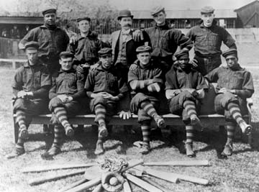
Primary? Or Secondary?
North dakota National History Day
http://www.pitchblackbaseball.com/northdakotabaseball.html

Slide 2
All historical resources are either Primary or Secondary . . . What does that mean?
Are primary sources the ones you use most often?
Are secondary sources the least important resources?
The answers are: NO! and NO!

Slide 3
So, what is a primary source?
What is a secondary source?
And, why should I care anyway?

Slide 4
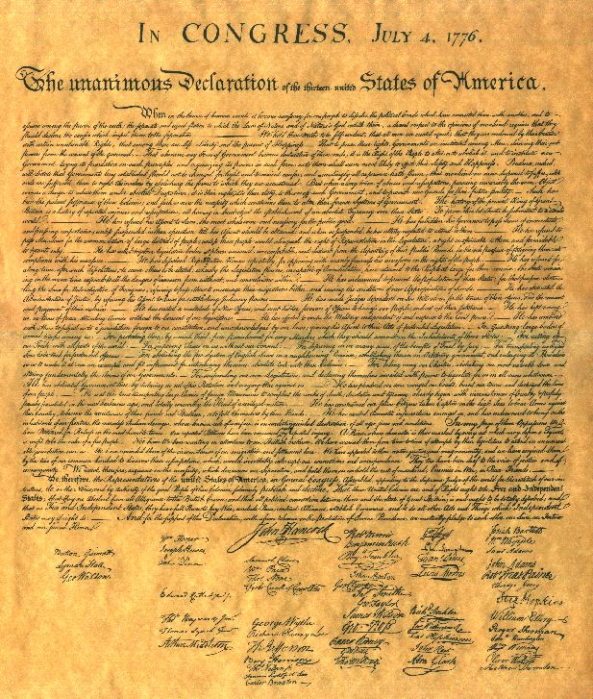
A primary source is one that was created by people who were present at the event, or were responsible for recording the event that you are researching.
A primary source is a record that was created in the time period you are researching.
The Declaration of Independence
is a primary source!

Slide 5
How do I identify a primary source?
Was it created in the time period you are researching?
Was it created by someone who was there?
Was it created by someone responsible for recording the event?
If the answer is YES to any of those questions, then you have a primary source!

Slide 6
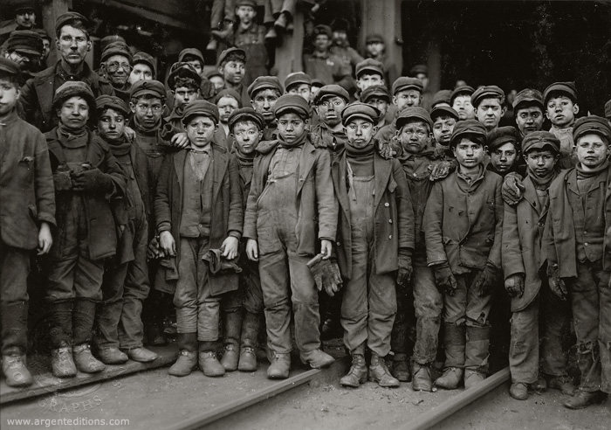
What are some examples of primary sources?
Letters that were written by someone who lived at the time of the event
Government documents that were written at the time of the event
Memoirs (even if written much later) by someone who was present at the event.
Photographs

Slide 7
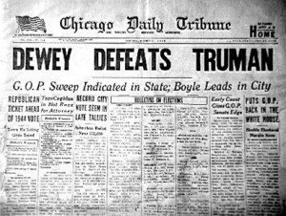
You didn’t mention newspapers. Are newspapers primary sources?
Newspapers are tricky. They are not good primary sources for details or facts of an event. Usually newspapers are printed too quickly and often have mistakes in the details.
However, newspapers are excellent resources for opinions. Newspapers tell us what people thought about an event at the time.

Slide 8
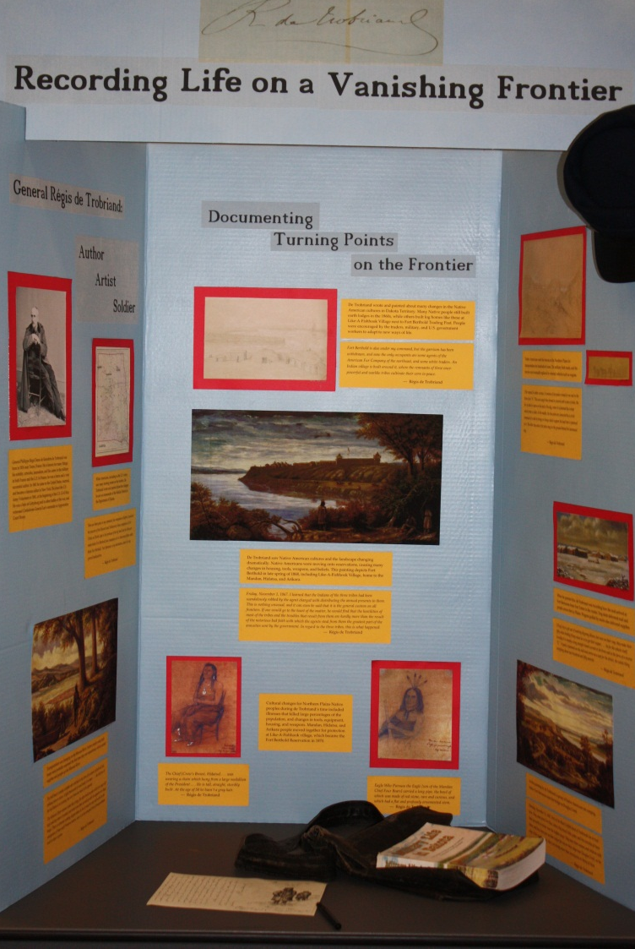
A secondary source is one that uses primary sources to analyze an historic event. The author of a secondary source draws conclusions from an examination of primary sources.
YOU are the author of a secondary
source when you develop a
National History Day project.

Slide 9
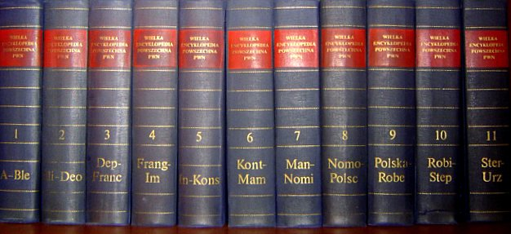
What are some examples of secondary sources?
Textbooks
History books – even those specifically about a single event (these are called monographs)
Documentaries
Encyclopedias

Slide 10
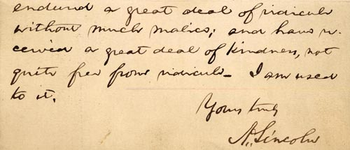
Are primary sources more important than secondary sources?
No. Both are important to historical research.
Each has its own purpose.

Slide 11
What is the purpose of secondary sources?
A good secondary source gives the researcher (you) all of the details about an event. The authors of books have researched all of the details. They also express an opinion (argument) about the event.
Websites and encyclopedias are a good starting point for your research. Sometimes websites and on-line encyclopedias have errors, or don’t include all of the information you need. Be careful when
using websites
(especially .coms)
and encyclopedias.

Slide 12
What is the purpose of primary sources?
Primary sources are the building blocks of historical research. Historians study primary sources and analyze them to try to understand WHY people did what they did in the past.
Historians develop their own opinions from the primary resources. Historians use primary sources to defend their opinions.

Slide 13
Using Historical Resources is like building a house
You need lumber, nails, glass, doors, roof shingles. These are the primary resources.

Slide 14
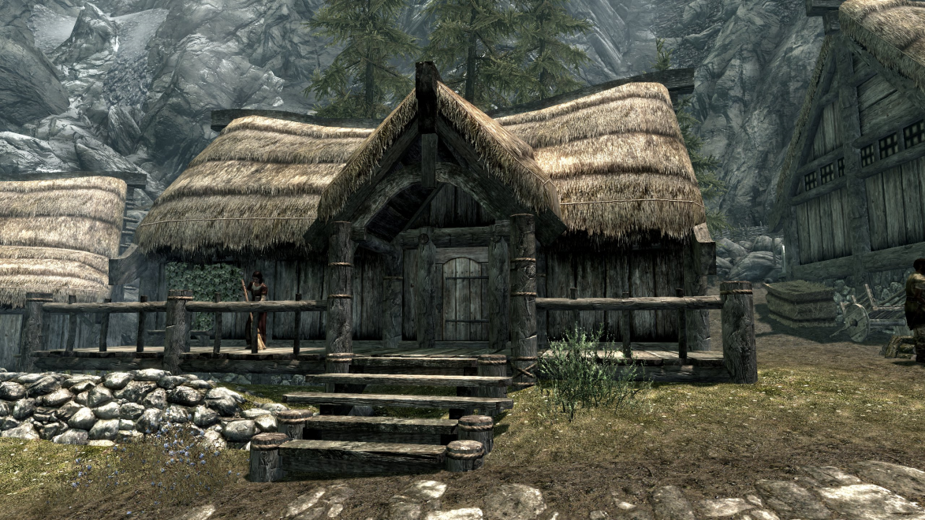
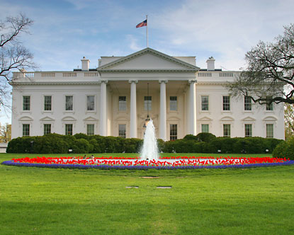
How you use the resources to build a house is up to you. But the house you build will be strong because you made the best use of your resources.

Slide 15
Now try this!
Look around your classroom or your house for resources that a historian might use someday.

Slide 16
did you find Any of these things?
a shopping list?
a newspaper?
your history textbook?
a receipt for something you bought?
photos of last summer’s camping trip?
toys?
Christmas letters?

Slide 17
Now, make two lists
Primary Sources Secondary Sources

Slide 18
Your Lists should look like this:
Primary Sources Secondary Sources
Camping photo text book
Christmas letter newspaper
Shopping list
Toys

Slide 19
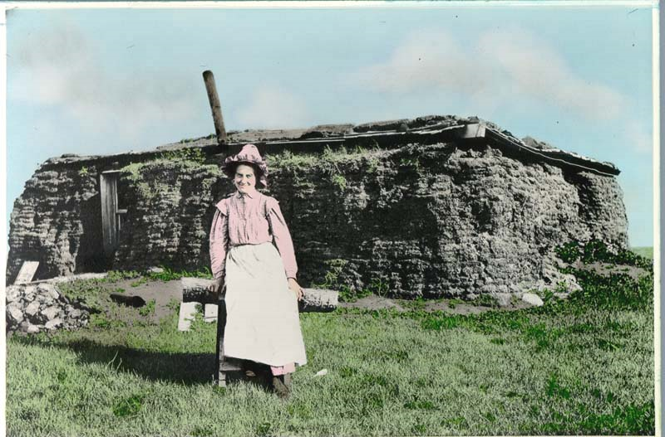
Now try it on your own.
Be sure you can explain why you chose to put the item on the primary source list or on the secondary source list.

